Slide 1

ANGULARJS
Custom Services
Gauthier Peel

Slide 2
Services
AngularJS services are substitutable objects that are wired together using dependency injection (DI).
You can use services to organize and share code across your app.
AngularJS services are:
Lazily instantiated – AngularJS only instantiates a service when an application component depends on it.
Singletons – Each component dependent on a service gets a reference to the single instance generated by the service factory.

Slide 3
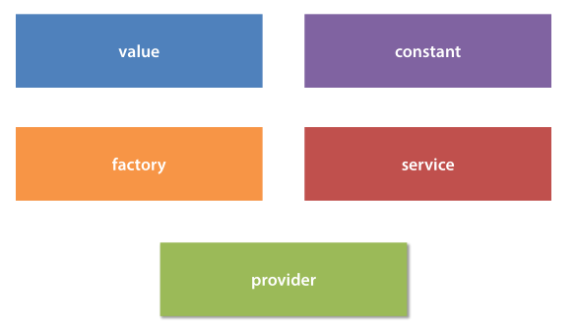
5 types of services

Slide 4
Services
AngularJS services are substitutable objects that are wired together using dependency injection (DI).
You can use services to organize and share code across your app.
AngularJS services are:
Lazily instantiated – AngularJS only instantiates a service when an application component depends on it.
Singletons – Each component dependent on a service gets a reference to the single instance generated by the service factory.

Slide 5
Constant
“The universal”
Constant service are used to store… constants!
A constant can be injected everywhere
app.constant('fooConfig', {
config1: true,
config2: "Default config2"
});

Slide 6
Constant
Full example
app = angular.module("app", []);
app.controller('MainCtrl', function($scope, fooConfig) {
$scope.fooConfig = fooConfig;
});
app.constant('fooConfig', {
config1: true,
config2: "Default config2"
});

Slide 7
Value
“The basic”
Value service are used to store… a single value!
Value can’t be injected into provider constructor or config functions.
app.value('foo', 'A simple value');

Slide 8
Value
Full example
app = angular.module("app", []);
app.controller('MainCtrl', function($scope, foo) {
$scope.foo = foo;
});
app.value('foo', 'A simple value');

Slide 9
Factory
“The classic”
We must provide a function that will gets called (we must return an object)
We can inject everything but providers on a factory
We can inject it everywhere except on the provider constructor and config functions.
app.factory('foo', function() {
var thisIsPrivate = "Private";
function getPrivate() {
return thisIsPrivate;
}
return {
variable: "This is public",
getPrivate: getPrivate
};
});

Slide 10
Factory
Full example
app = angular.module("app", []);
app.controller('MainCtrl', function($scope, foo) {
$scope.foo = foo;
});
app.factory('foo', function() {
var thisIsPrivate = "Private";
function getPrivate() {
return thisIsPrivate;
}
return {
variable: "This is public",
getPrivate: getPrivate
};
});

Slide 11
Service
“The new kid in town”
We must provide a constructor function that will be called with new
We can inject everything but providers
We can inject it everywhere except on the provider constructor and config functions.
app.service('foo', function() {
var thisIsPrivate = "Private";
this.variable = "This is public";
this.getPrivate = function() {
return thisIsPrivate;
};
});

Slide 12
Service
Full example
app = angular.module("app", []);
app.controller('MainCtrl', function($scope, foo) {
$scope.foo = foo;
});
app.service('foo', function() {
var thisIsPrivate = "Private";
this.variable = "This is public";
this.getPrivate = function() {
return thisIsPrivate;
};
});

Slide 13
Provider
“The configurable”
Provider is the parent of almost all the other services (all but constant) and it is also the most complex but more configurable one.
We needs to return a function called $get which is what we inject on the other components.
We can configure a provider in the config function
Injection:
To inject the full we need => use name + ‘Provider’
To inject its $get function => use name

Slide 14
Provider
Full example
app = angular.module("app", []);
app.provider('foo', function() {
var thisIsPrivate = "Private";
return {
setPrivate: function(newVal) {
thisIsPrivate = newVal;
},
$get: function() {
function getPrivate() {
return thisIsPrivate;
}
return {
variable: "This is public",
getPrivate: getPrivate
};
}
};
});
app.config(function(fooProvider) {
fooProvider.setPrivate('New value from config');
});
app.controller('MainCtrl', function($scope, foo) {
$scope.foo = foo;
});

Slide 15





Summary of Possible injections
Config function
Controller

Slide 16

Use service()

Slide 17
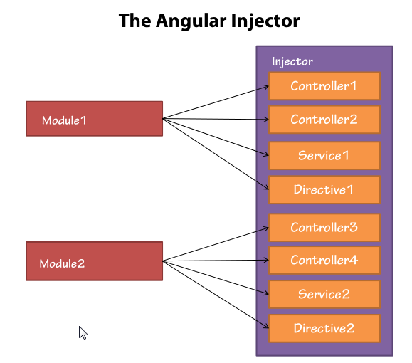

Naming a service
Do not use $ as a prefix => only for angular services ($http, $q…)
There is NO name isolation between modules => Controller names, Services names Directives names are shared

